Slide 1
X-Field Top Structure Map
N
11100
10900
10700
10500
4
10300
5
10100
6
9900
1
3
2
1
2 Kms
Exploration Well Top
Reservoir Location
9800
Depth to Top Reservoir
(Feet Subsea)

Slide 2
X-Field Top Structure Map
N
4
5
6
1
3
2
1
2 Kms
Exploration Well Top
Reservoir Location
9800
Depth to Top Reservoir
(Feet Subsea)

Slide 3
11100
10900
10700
10500
4
10300
5
10100
6
9900
1
3
2

Slide 4
4
5
6
1
3
2

Slide 5
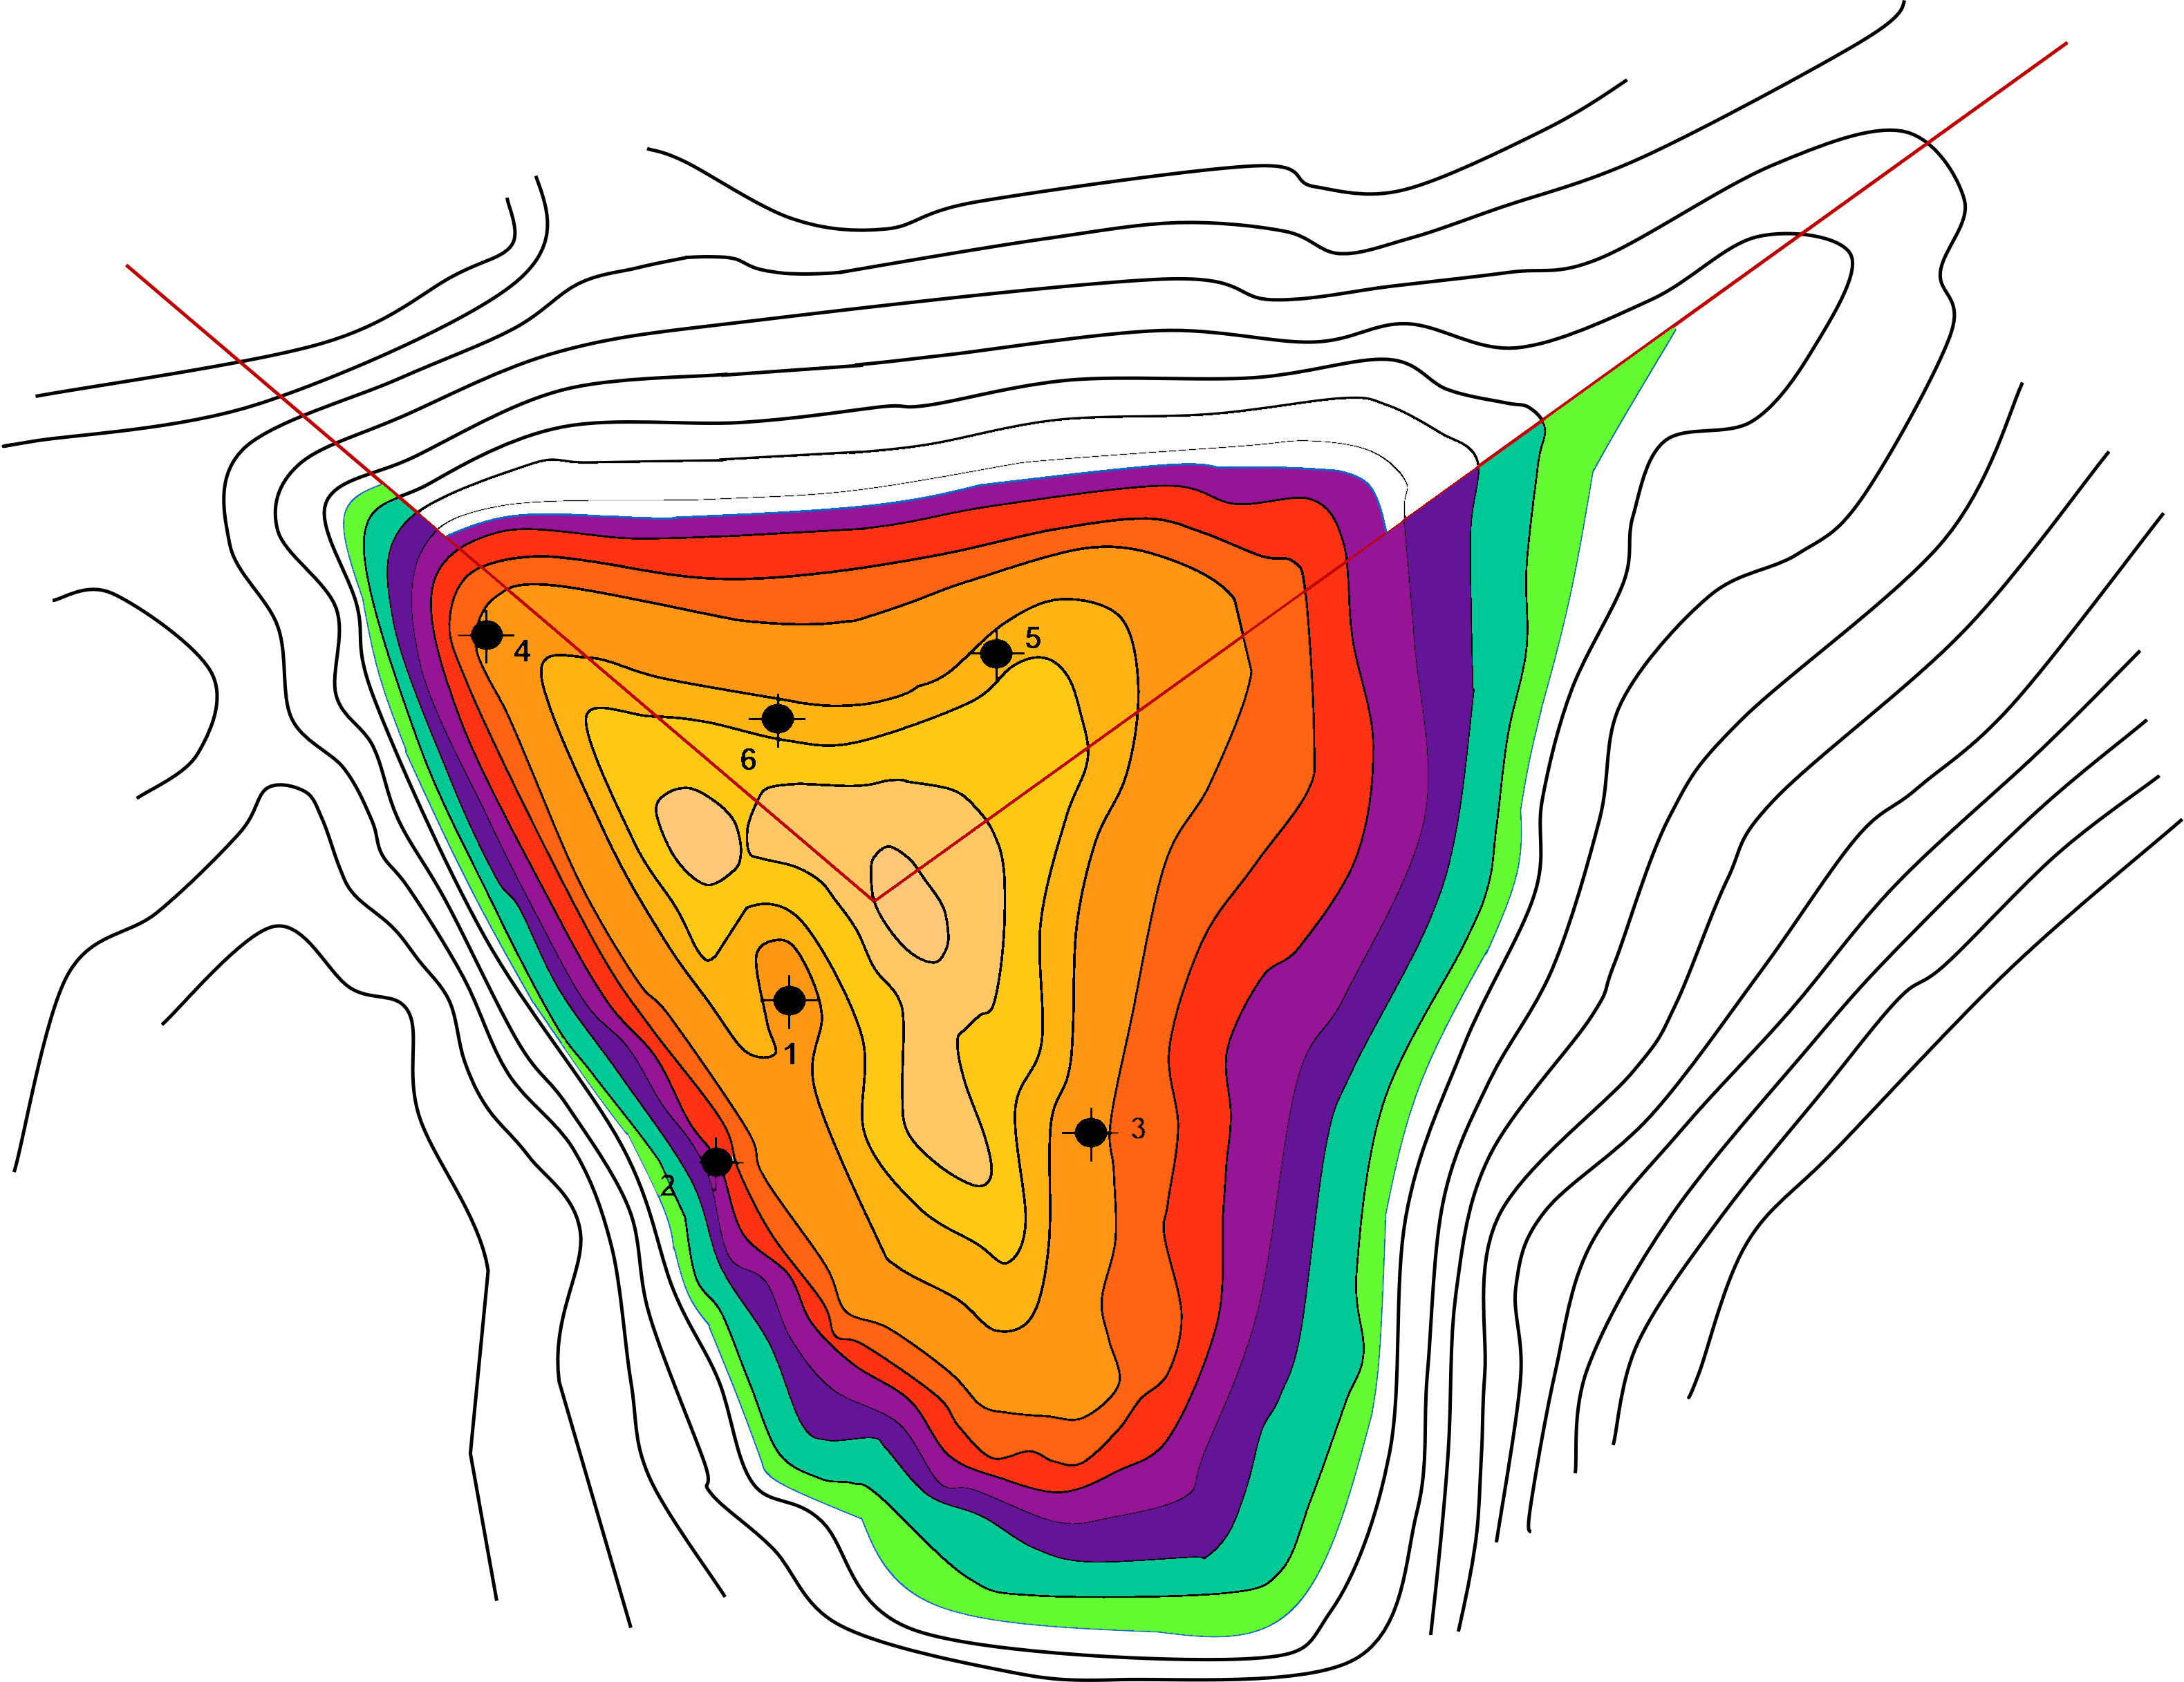
X-Field Top Structure Map
N
1
2 Kms
Exploration Well Top
Reservoir Location
9800
Depth to Top Reservoir
(Feet Subsea)

Slide 6
X-Field Top Structure Map
N
11100
10900
10700
10500
10300
10100
9900
1
2 Kms
Exploration Well Top
Reservoir Location
9800
Depth to Top Reservoir
(Feet Subsea)

